Slide 1
Manipulating Data
Notes:
Schedule: Timing Topic
60 minutes Lecture
30 minutes Practice
90 minutes Total

Slide 2
Objectives
After completing this lesson, you should be
able to do the following:
Describe each DML statement
Insert rows into a table
Update rows in a table
Delete rows from a table
Notes:
Lesson Aim
In this lesson, you learn how to insert rows into a table, update existing rows in a table, and delete existing rows from a table. You also learn how to control transactions with the COMMIT, SAVEPOINT, and ROLLBACK statements.

Slide 3
Data manipulation language (DML)
*INSERT
*UPDATE
*DELETE
*MERGE

Slide 4
Data Manipulation Language
A DML statement is executed when you:
Add new rows to a table
Modify existing rows in a table
Remove existing rows from a table
Notes:
Data Manipulation Language
Data manipulation language (DML) is a core part of SQL. When you want to add, update, or delete data in the database, you execute a DML statement. A collection of DML statements that form a logical unit of work is called a transaction.
Consider a banking database. When a bank customer transfers money from a savings account to a checking account, the transaction might consist of three separate operations: decrease the savings account, increase the checking account, and record the transaction in the transaction journal. The Oracle server must guarantee that all three SQL statements are performed to maintain the accounts in proper balance. When something prevents one of the statements in the transaction from executing, the other statements of the transaction must be undone.
Instructor Note
DML statements can be issued directly in iSQL*Plus, performed automatically by tools such as Oracle Forms Services, or programmed with tools such as the 3GL precompilers.
Every table has INSERT, UPDATE, and DELETE privileges associated with it. These privileges are automatically granted to the creator of the table, but in general they must be explicitly granted to other users.
Starting with Oracle 7.2, you can place a subquery in the place of the table name in an UPDATE statement, essentially the same way you use a view.

Slide 5
The INSERT Statement Syntax
Add new rows to a table by using the INSERT statement.
Only one row is inserted at a time with this syntax.
INSERT INTO table [(column [, column...])]
VALUES (value [, value...]);
Notes:
Adding a New Row to a Table (continued)
You can add new rows to a table by issuing the INSERT statement.
In the syntax:
table is the name of the table
column is the name of the column in the table to populate
value is the corresponding value for the column
Note: This statement with the VALUES clause adds only one row at a time to a table.

Slide 6
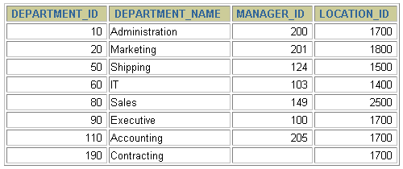
Adding a New Row to a Table
New
row
DEPARTMENTS
…insert a new row into the DEPARMENTS table…
Notes:
Adding a New Row to a Table
The slide graphic illustrates adding a new department to the DEPARTMENTS table.

Slide 7
Inserting New Rows
Insert a new row containing values for each column.
List values in the default order of the columns in the table.
Optionally, list the columns in the INSERT clause.
Enclose character and date values within single quotation marks.
INSERT INTO departments(department_id, department_name,
manager_id, location_id)
VALUES (70, 'Public Relations', 100, 1700);
1 row created.
Notes:
Adding a New Row to a Table (continued)
Because you can insert a new row that contains values for each column, the column list is not required in the INSERT clause. However, if you do not use the column list, the values must be listed according to the default order of the columns in the table, and a value must be provided for each column.
DESCRIBE departments
For clarity, use the column list in the INSERT clause. Enclose character and date values within single quotation marks; it is not recommended to enclose numeric values within single quotation marks.
Number values should not be enclosed in single quotes, because implicit conversion may take place for numeric values assigned to NUMBER data type columns if single quotes are included.

Slide 8
Inserting Rows with Null Values
Implicit method: Omit the column from the column list.
INSERT INTO departments (department_id,
department_name )
VALUES (30, 'Purchasing');
1 row created.
Explicit method: Specify the NULL keyword in the VALUES clause.
INSERT INTO departments
VALUES (100, 'Finance', NULL, NULL);
1 row created.
Notes:
Methods for Inserting Null Values
Be sure that you can use null values in the targeted column by verifying the Null? status with the iSQL*Plus DESCRIBE command.
The Oracle Server automatically enforces all data types, data ranges, and data integrity constraints. Any column that is not listed explicitly obtains a null value in the new row.
Common errors that can occur during user input:
Mandatory value missing for a NOT NULL column
Duplicate value violates uniqueness constraint
Foreign key constraint violated
CHECK constraint violated
Data type mismatch
Value too wide to fit in column

Slide 9
Inserting Special Values
The SYSDATE function records the current date
and time.
INSERT INTO employees (employee_id,
first_name, last_name,
email, phone_number,
hire_date, job_id, salary,
commission_pct, manager_id,
department_id)
VALUES (113,
'Louis', 'Popp',
'LPOPP', '515.124.4567',
SYSDATE, 'AC_ACCOUNT', 6900,
NULL, 205, 100);
1 row created.
Notes:
Inserting Special Values by Using SQL Functions
You can use functions to enter special values in your table.
The slide example records information for employee Popp in the EMPLOYEES table. It supplies the current date and time in the HIRE_DATE column. It uses the SYSDATE function for current date and time.
You can also use the USER function when inserting rows in a table. The USER function records the current username.
Confirming Additions to the Table
SELECT employee_id, last_name, job_id, hire_date, commission_pct
FROM employees
WHERE employee_id = 113;

Slide 10
Inserting Specific Date Values
Add a new employee.
Verify your addition.
INSERT INTO employees
VALUES (1141,
'Den', 'Raphealy',
'DRAPHEAwwL', '515.127.4561','03.02.1999',
'AC_ACCOUNT', 11000, NULL, 100, 30);
1 row created.
Notes:
Inserting Specific Date and Time Values
The DD-MON-YY format is usually used to insert a date value. With this format, recall that the century defaults to the current century. Because the date also contains time information, the default time is midnight (00:00:00).
If a date must be entered in a format other than the default format, for example, with another century, or a specific time, you must use the TO_DATE function.
The example on the slide records information for employee Raphealy in the EMPLOYEES table. It sets the HIRE_DATE column to be February 3, 1999. If you use the following statement instead of the one shown on the slide, the year of the hire_date is interpreted as 2099.
INSERT INTO employees
VALUES (114,
'Den', 'Raphealy',
'DRAPHEAL', '515.127.4561',
'03-FEB-99',
'AC_ACCOUNT', 11000, NULL, 100, 30);
If the RR format is used, the system provides the correct century automatically, even if it is not the current one.
Instructor Note
The default date format in Oracle9i is DD-MON-RR. Prior to release 8.16, the default format was DD-MON-YY.

Slide 11
The UPDATE Statement Syntax
Modify existing rows with the UPDATE statement.
Update more than one row at a time, if required.
UPDATE table
SET column = value [, column = value, ...]
[WHERE condition];
Notes:
Updating Rows
You can modify existing rows by using the UPDATE statement.
In the syntax:
table is the name of the table
column is the name of the column in the table to populate
value is the corresponding value or subquery for the column
condition identifies the rows to be updated and is composed of column names expressions, constants, subqueries, and comparison operators
Confirm the update operation by querying the table to display the updated rows.
For more information, see Oracle9i SQL Reference, “UPDATE.”
Note: In general, use the primary key to identify a single row. Using other columns can unexpectedly cause several rows to be updated. For example, identifying a single row in the EMPLOYEES table by name is dangerous, because more than one employee may have the same name.

Slide 12
Updating Rows in a Table
Specific row or rows are modified if you specify the WHERE clause.
All rows in the table are modified if you omit the WHERE clause.
UPDATE employees
SET department_id = 70
WHERE employee_id = 113;
1 row updated.
UPDATE copy_emp
SET department_id = 110;
22 rows updated.
Notes:
Updating Rows (continued)
The UPDATE statement modifies specific rows if the WHERE clause is specified. The slide example transfers employee 113 (Popp) to department 70.
If you omit the WHERE clause, all the rows in the table are modified.
SELECT last_name, department_id
FROM copy_emp;
Note: The COPY_EMP table has the same data as the EMPLOYEES table.
…

Slide 13
Updating Rows: Integrity Constraint Error
UPDATE employees
SET department_id = 55
WHERE department_id = 110;
department number is used as a foreign key in the EMPLOYEES table.
UPDATE employees
*
ERROR at line 1:
ORA-02291: integrity constraint (HR.EMP_DEPT_FK) violated - parent key not found
Department number 55 does not exist
Notes:
Integrity Constraint Error
If you attempt to update a record with a value that is tied to an integrity constraint, an error is returned.
In the example on the slide, department number 55 does not exist in the parent table, DEPARTMENTS, and so you receive the parent key violation ORA-02291.
Note: Integrity constraints ensure that the data adheres to a predefined set of rules. A subsequent lesson covers integrity constraints in greater depth.
Instructor Note
Explain integrity constraints, and review the concepts of primary key and foreign key.

Slide 14
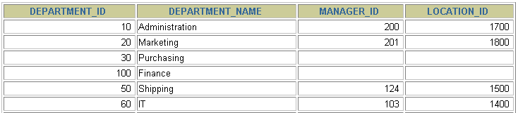
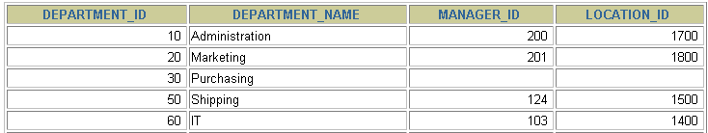
Removing a Row from a Table
DEPARTMENTS
Exp. Remove the Finance department from the DEPARTMENTS table
Delete a row from the DEPARTMENTS table.
Notes:
Removing a Row from a Table
The slide graphic removes the Finance department from the DEPARTMENTS table (assuming that there are no constraints defined on the DEPARTMENTS table).
Instructor Note
After all the rows have been eliminated with the DELETE statement, only the data structure of the table remains. A more efficient method of emptying a table is with the TRUNCATE statement. You can use the TRUNCATE statement to quickly remove all rows from a table or cluster. Removing rows with the TRUNCATE statement is faster than removing them with the DELETE statement for the following reasons:
The TRUNCATE statement is a data definition language (DDL) statement and generates no rollback information. It is covered in a subsequent lesson.
Truncating a table does not fire the delete triggers of the table.
If the table is the parent of a referential integrity constraint, you cannot truncate the table. Disable the constraint before issuing the TRUNCATE statement.

Slide 15
The DELETE Statement
You can remove existing rows from a table by using
the DELETE statement.
DELETE [FROM] table
[WHERE condition];
Notes:
Deleting Rows
You can remove existing rows by using the DELETE statement.
In the syntax:
table is the table name condition identifies the rows to be deleted and is composed of column names, expressions, constants, subqueries, and comparison operators
Note: If no rows are deleted, a message “0 rows deleted.” is returned:
For more information, see Oracle9i SQL Reference, “DELETE.”
Instructor Note
The DELETE statement does not ask for confirmation. However, the delete operation is not made permanent until the data transaction is committed. Therefore, you can undo the operation with the ROLLBACK statement if you make a mistake.

Slide 16
Deleting Rows from a Table
Specific rows are deleted if you specify the WHERE clause.
All rows in the table are deleted if you omit the WHERE clause.
DELETE FROM departments
WHERE department_name = 'Finance';
1 row deleted.
DELETE FROM copy_emp;
22 rows deleted.
Notes:
Deleting Rows (continued)
You can delete specific rows by specifying the WHERE clause in the DELETE statement. The slide example deletes the Finance department from the DEPARTMENTS table. You can confirm the delete operation by displaying the deleted rows using the SELECT statement.
SELECT *
FROM departments
WHERE department_name = 'Finance';
no rows selected.
If you omit the WHERE clause, all rows in the table are deleted. The second example on the slide deletes all the rows from the COPY_EMP table, because no WHERE clause has been specified.
Example
Remove rows identified in the WHERE clause.
DELETE FROM employees
WHERE employee_id = 114;
1 row deleted.
DELETE FROM departments
WHERE department_id IN (30, 40);
2 rows deleted.

Slide 17
Deleting Rows: Integrity Constraint Error
DELETE FROM departments
WHERE department_id = 60;
department number is used as a foreign key in the EMPLOYEES table.
DELETE FROM departments
*
ERROR at line 1:
ORA-02292: integrity constraint (HR.EMP_DEPT_FK) violated - child record found
You cannot delete a row that contains a primary key that is used as a foreign key in another table.
Notes:
Integrity Constraint Error
If you attempt to delete a record with a value that is tied to an integrity constraint, an error is returned.
The example on the slide tries to delete department number 60 from the DEPARTMENTS table, but it results in an error because department number is used as a foreign key in the EMPLOYEES table. If the parent record that you attempt to delete has child records, then you receive the child record found violation ORA-02292.
The following statement works because there are no employees in department 70:
DELETE FROM departments
WHERE department_id = 70;
1 row deleted.
Instructor Note
If referential integrity constraints are in use, you may receive an Oracle server error message when you attempt to delete a row. However, if the referential integrity constraint contains the ON DELETE CASCADE option, then the selected row and its children are deleted from their respective tables.

Slide 18
Overview of the Explicit Default Feature
With the explicit default feature, you can use the DEFAULT keyword as a column value where the column default is desired.
The addition of this feature is for compliance with the SQL: 1999 Standard.
This allows the user to control where and when the default value should be applied to data.
Explicit defaults can be used in INSERT and UPDATE statements.
Notes:
Explicit Defaults
The DEFAULT keyword can be used in INSERT and UPDATE statements to identify a default column value. If no default value exists, a null value is used.

Slide 19
Using Explicit Default Values
DEFAULT with INSERT:
DEFAULT with UPDATE:
INSERT INTO departments
(department_id, department_name, manager_id)
VALUES (300, 'Engineering', DEFAULT);
UPDATE departments
SET manager_id = DEFAULT WHERE department_id = 10;
Notes:
Using Explicit Default Values
Specify DEFAULT to set the column to the value previously specified as the default value for the column. If no default value for the corresponding column has been specified, Oracle sets the column to null.
In the first example shown, the INSERT statement uses a default value for the MANAGER_ID column. If there is no default value defined for the column, a null value is inserted instead.
The second example uses the UPDATE statement to set the MANAGER_ID column to a default value for department 10. If no default value is defined for the column, it changes the value to null.
Note: When creating a table, you can specify a default value for a column. This is discussed in the “Creating and Managing Tables” lesson.

Slide 20
EXAMPLE 1: DEFAULT
Bir önceki örnek için (oracle’ın kendi tabloları ile ilgili örneklerde) default değerler, tanımlama sırasında atanmadığından (varsayılan değer tanımlanmadığından) NULL olarak görülür.
INSERT INTO departments
(department_id, department_name, manager_id)
VALUES (3010, 'Engineering', DEFAULT);
Daha sonra tablonun içeriğini görüntülemek için department_id si 3010 olan kayıtı listeleyelim.
select * from departments
where department_id=3010

Slide 21
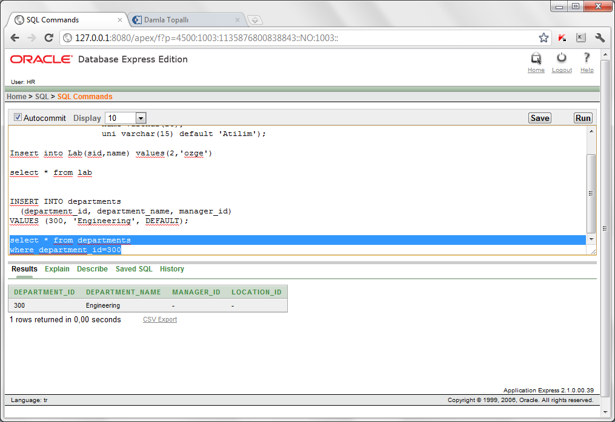
Manager_id değerinin NULL görünmesinin sebebi departments tablosu yaratılırken herhangi bir default değer atanmamasıdır. Önceden olan tablolar için default değerin atanıp atanmadığını DECRIBE (DESC) tablo_adı komutu ile görebiliriz

Slide 22
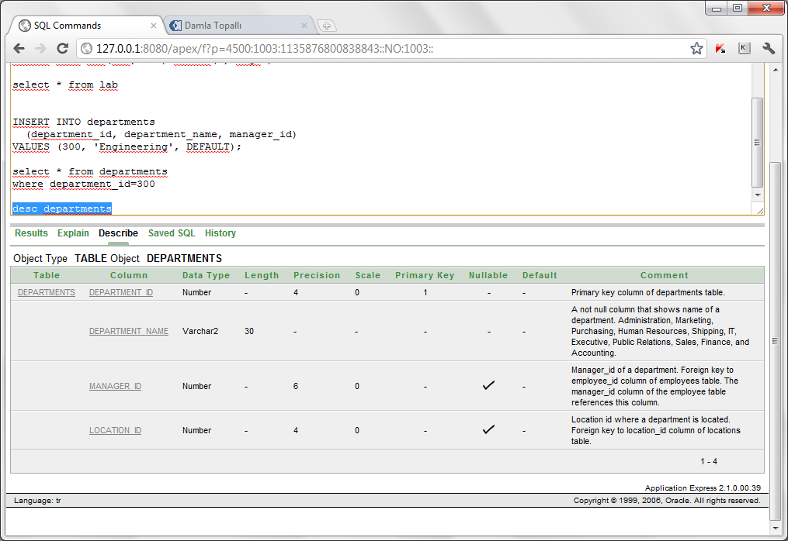
DESC departments
Aşağıda görüldüğü üzere departments tablosunda hiçbir niteliğe default değer atanmamıştır.

Slide 23
Example 2- Default Değer Atama
Create table Lab(
sid int not null primary key,
name varchar(25),
uni varchar(15) default 'Atilim');
Bu tabloya sid si 1, ismi damla olan ögrenciyi ekleyelim.
Insert into Lab values(1,'damla') → HATA!
Burda lab tablosunun her bir niteliği için 3 değer girmemiz lazım. (sırasıyla sid,name ve uni). Bu statement için hata alırız: ORA-00947: not enough values

Slide 24
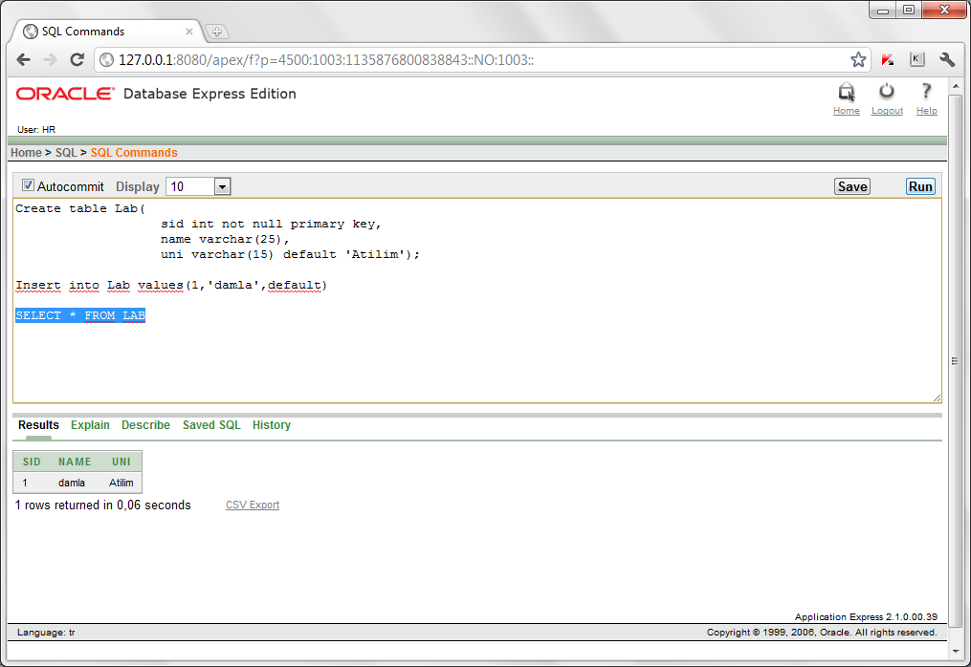
Insert into Lab values(1,'damla',default) veya
Insert into Lab(sid,name) values(1,'damla')
Şimdi select * ile Lab tablosundaki kayıtları getirelim:
Select * from Lab

